Slide 1

ORDER OF BATTLE

Slide 2
CONTENT
EXPLANATION
Ground Forces
Corps HQ
Division HQ
Brigade HQ
Armor Division
Air Defense Division
Artillery Battalion
Armor Brigade
Logistics Battalion
Named units
IV. Corps
Air Defence Forces (Airforce)
Air Defence Forces

Slide 3
Explanation# 1
IV CORPS
Rank of commanding officer (generals)
Name of unit
Armor Platoon
3x MBT
Types of vehicles in unit
Artillery Battery
Dashed line indicate that this unit is supporting , and is not organic to the unit.
Armor Platoon
Armor Platoon
Armor Platoon
3x MBT
Indicates similar units
(In this example 3 Armor platoons)
3x MBT
3x MBT
Maneuver units:
Armor, Mechanized and Motorized
Brigade
Brigade is the normal fighting unit (contains air defence, manueuver unit, logistics and artillery)
Division:
Offensive or defensive, this is the normal unit size for a sector
Corps:
A full front, contains additional Corps resources and a headquarter.

Slide 4
Explanation #2
Ground Forces
Ground forces are the combat manuever forces. This includes air defense forces assigned to the ground forces in direct support to protect the combat maneuver forces
Main maneuver ground forces are divided into:
Motorized: Wheeled infantry (APC)
Mechanized: Tracked Infantry Fighting Vehicles
Armor: Main Battle Tanks
These three are the main fighting force of any enemy unit. They are supported by Artillery, Air Defenses, Logistics, Recon
Air Defence Forces
Air Defence forces are Air Defences controlled by the Air Force

Slide 5
Explanation #3: Example
FLOT
Armor Battalion
Armor Battalion
Armor Brigade
Armor Battalion
Armor Battalion
Armor Battalion
Armor Brigade
Armored Division
Armor Battalion
Armor Battalion
Armor Battalion
Armor Brigade
Armor Battalion
Armored Division Area of Operations
CORPS
Mechanized Battalion
Mechanized Division Area of Operations
Mechanized Battalion
Mechanized Brigade
Mechanized Battalion
Mechanized Battalion
Mechanized Battalion
Mechanized Brigade
Mechanized Division

Slide 6
Explanation #5: Hierarchy
CORPS
Special Operations Regiment
Recon Regiment
Air Defence Division
Airborne Brigade
Rocket Artillery Brigade
Motorized Division
Armored Division
Mechanized Division
Missile Brigade
C2 Battalion
Air Defence Regiment
Armor Brigade
Logistics Battalion
Rocket Artillery BN
Armor Brigade
Armor Brigade
Air Defence BN
Armor Battalion
Artillery BN
Armor Battalion
Armor Battalion
Under the Corps, the Motorized, Armored and Mechanized Divisions have their own structure. In this example, the Armored Division is shown.
Below Armor Division is the Armor Brigade, also shown.

Slide 7
Explanation #4: Distances
Air Assault Brigade
Armor Battalion
Armor Brigade
Armored Division
CORPS
100-0km
0-10km
10-25km
20-50km
40-100km
Doctrinal distance from FLOT
NOTE: Air Assault Brigade jumping in behind enemy lines

Slide 8
GROUND FORCES
This section includes information about the combat maneuver forces
This section contain generic information about unit size and organization

Slide 9
Corps
CORPS
Armored Division
Motorized Division
Mechanized Division
Air Defense Battalion
Missile Brigade
Rocket Artillery Brigade
SA-6
SCUD
MLRS
Special Operations Regiment
Air Defense Divison
Reconissance Regiment
Airborne Brigade

Slide 10
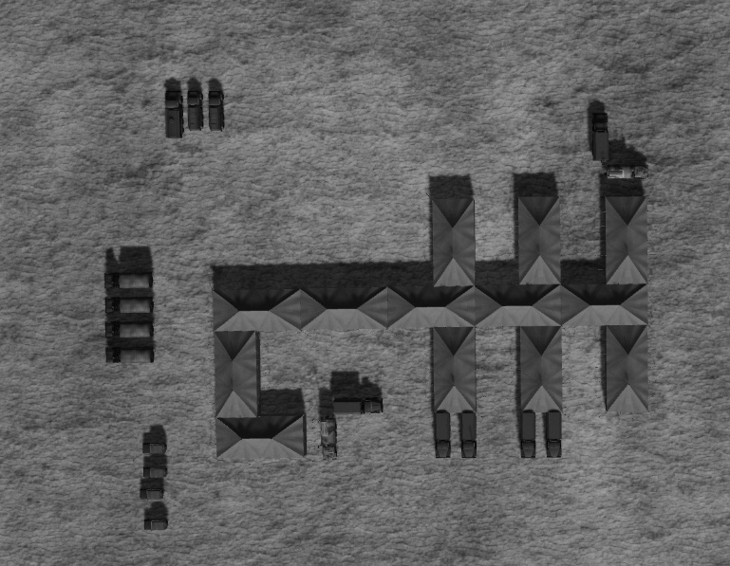
Corps HQ
Fuel for generators
Generator vehicles
CP SKP 11 ATC Mobile Command Post
CP Ural 375 PBU
Supply trucks
13 tents
VIP Transport
CP SKP 11 ATC Mobile Command Post
CP Ural 375 PBU
Corps HQ is in rear area and are protectected by a SA6 Battalion.
All Corps Headquarters will have the same layout on the tents

Slide 11
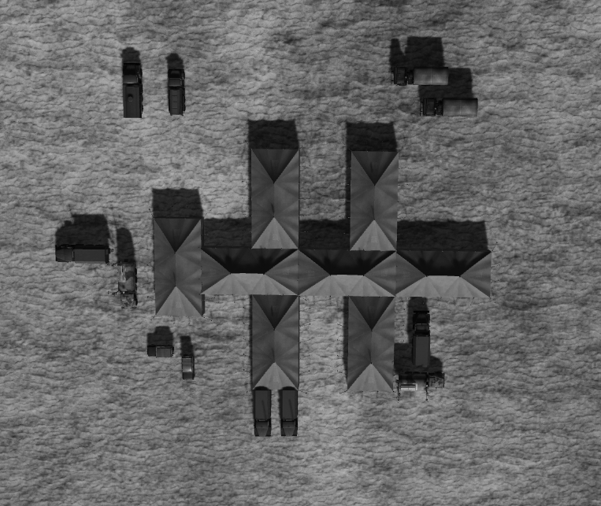
Divison HQ
All Division Headquarters will have the same layout on the tents

Slide 12
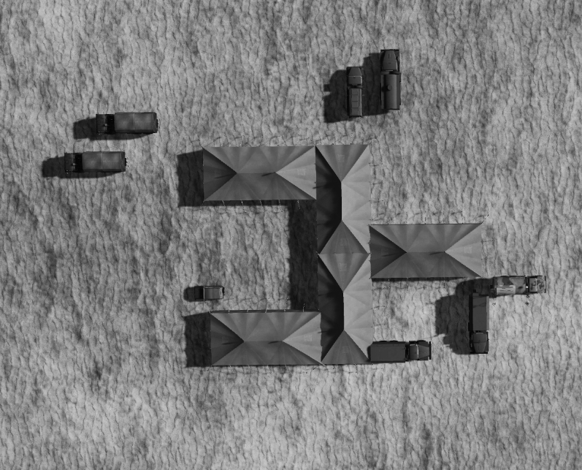
Brigade HQ
All Brigade Headquarters will have the same layout on the tents

Slide 13
ARMOR Division
Armor Div
Armor Brigade
FARP
Supply points
Logistics Battalion
Armor Brigade
MLRS
(BM-21)
Rocket Artillery BN
Armor Brigade
Air Defence Regiment
Vehicles
Tents
C2 Battalion

Slide 14
ARMOR Brigade
Armor Brigade
Armor BN
Artillery BN
Armor BN
Armor BN
Air Defence BN

Slide 15
Armor BN
Armor BN
Armor Company
Logistics Company
Artillery Battery
Armor Company
Armor Company
Air Defence Battery
Armor Platoon
Fuel Platoon
Armor Platoon
Armor Platoon
3x MBT
3x Fuel trucks
3x MBT
3x MBT
Ammo Platoon
3x Supply trucks

Slide 16
Artillery Battalion
Artillery BN
Artillery Battery
Logistics Company
Artillery Battery
Artillery Battery
Artillery Section
Ammo Platoon
Artillery Section
Ammo Platoon
Ammo Platoon
3x Arty
3x Supply trucks
3x Arty
3x Supply trucks
3x Supply trucks

Slide 17
Air Defence Regiment
Air Defence Regiment
Air Defence Battalion
SA-8 BN
SA-15 BN

Slide 18
Air Defence Battalion
Air Defence Battalion
Air Defence Battery
Air Defence Battery
Air Defence Battery
Air Defence Battalion supportgs Maneuver Regiment
1x Air Defence Battery supporting a maneuver BN

Slide 19
Air Defence Battery
Air Defence Battery
Air Defence Platoon
Air Defence Platoon
Air Defence Platoon comes in 4 Different variants:
#1: 1x ZSU23/4 + SA-9 (Motorized)
#2: 1x ZSU23/4 + SA-13 (Mechanized)
#3: 1x ZSU23/4 + SA-8 (Armor)
#4: 1x SA-19+ SA-9
#5: 1x SA-19 + SA-13
#6: 1x SA-19 + SA-8

Slide 20
Logistics Battalion
Logistics BN
Fuel Company
Supply Company
Ammo Company
Fuel Platoon
Supply Platoon
Ammo Platoon
3x Fuel trucks
3x Supply trucks
3xSupply trucks
Fuel Platoon
Supply Platoon
Ammo Platoon
3x Fuel trucks
3x Supply trucks
3x Supply trucks

Slide 21
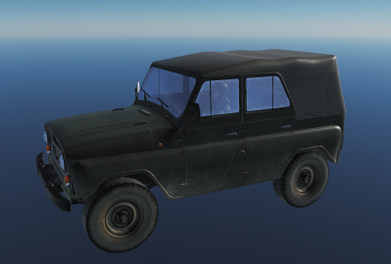
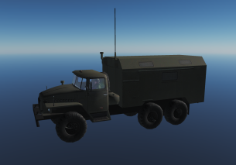
Recon Regiment
Reconissance Regiment
Reconissance Battalion
Long Range Recon Battalion
Special Recon Battalion
UAZ-469
CP URAL-375 PBU
Long Range Recon:
Long range Recon uses RW or infiltrates by foot, deep behind enemy lines.
Primary task to locate logistics, Artillery and C2 of enemy forces
Special Recon:
Uses Electronic warfare, both for jamming, direction finding, and collecting intelligence on enemy forces.

Slide 22
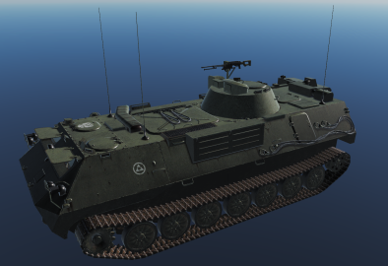
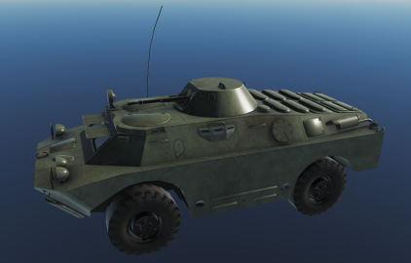
Recon BN
Reconissance Battalion
Recon
Company
Recon
Company
Recon
Company
Recon
Company
Wheeled
Recon Platoon
Recon Platoon
Recon Platoon
Recon Platoon
Recon Platoon
Recon Platoon
Recon Platoon
Recon Platoon
Recon Platoon
NOTE: Recon Company is either tracked or wheeled
In each platoon there are 2 vehicles
Recon units work together in pairs.
ARV MTLB-U BOMAN
ARV BRDM-2

Slide 23
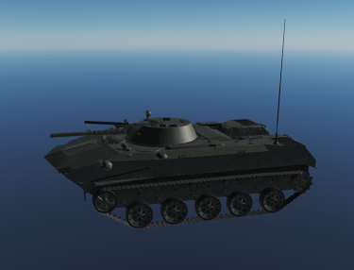
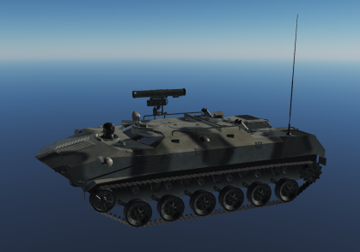
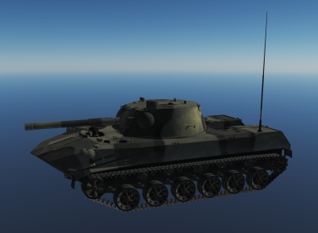
Air Assault Brigade
Air Assault Brigade
Air Assault BN
Air Assault BN
Air Assault BN
Inserted via IL-76MD
One IL-76 can carry 3 BMD (1 Airborne Platoon)
IFV BMD-1
ARV BTR-RD
SPH 2S9 NONA

Slide 24
Specific units
This next section will contain specific units (named units)

Slide 25
IV Corps
IV CORPS
2nd Armored Division
4th Armored Division
6th Mechanized Division
8th
Air Defense Regiment
10th Missile Brigade
12th Artillery Brigade
SA-6
SCUD
MLRS
14th Special Operations Regiment
16th Air Defense Divison

Slide 26
Air Defense Forces
This section includes information about the Air Defense Forces protecting critical installations.
The Air Defense Forces are static locations
Controlled by the Air Force.

Slide 27
Air Defense Division
Air Defence Div
SA-3 Regiment
SA-2 Regiment
SA-6 Regiment
SA-6 BN
SA-6 BN
SA-6 BN
SA-2 BN
SA-3 BN
SA-6 BN

Slide 28
SA-6 Regiment
SA-6 Regiment
SA-6 BN
Early Warning Battery
Air Defence Battery
SA-6 BN

Slide 29
Air Defence Brigade
8th Air Defense Brigade
SA-10

